Slide 1
Risk Assessment using What-IF Checklist
Group Discussion

Slide 2
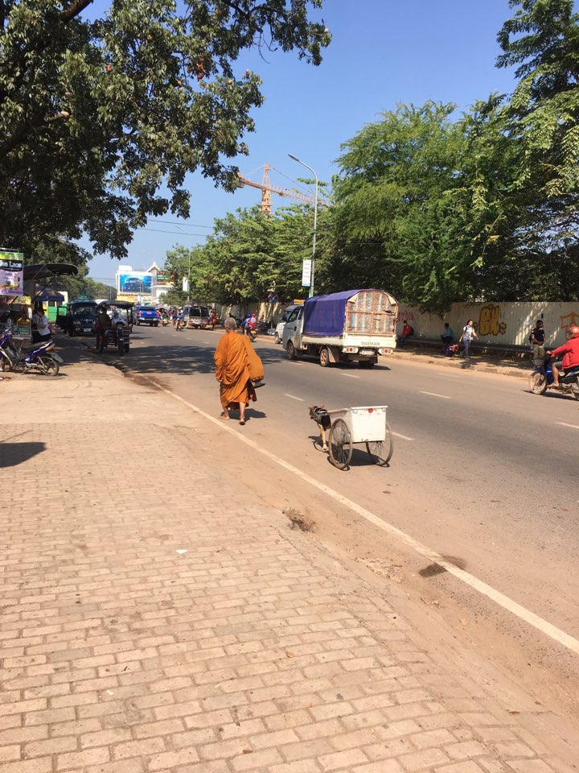
Safety work is must to do in your life.
Safety work is wanted to do in your life.

Slide 3
Incident by Chlorine Gas
3

Slide 6
Process Description
6

Slide 7
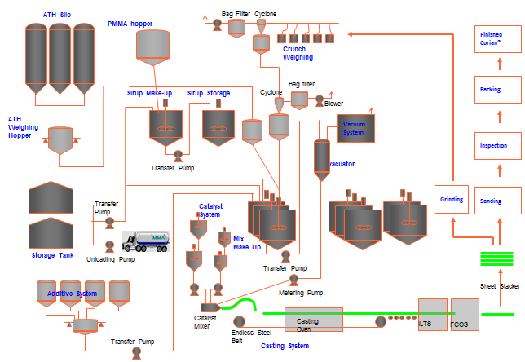

Slide 8
Group Discussion Process
8

Slide 9
Group Discussion Process
1. Divide Four Group
2. Refresh for Risk Assessment Tool
- Task Risk Assessment
3. Decide the group leader & scriber
4. Discussion & Assessment
5. Prepare the report
6. Presentation by the leader

Slide 10
Four Group
Group 1 | Group 2 | Group 3 | Group 4

Slide 11
Group 1_Question No.1 to 11
1. The flexible hose is leaked which release Chlorine gas.
2. Raw materials freezes in the pipe lines.
3. Raw materials freezes in the tank.
4. The tank truck is hooked up to a wrong tank.
5. The truck is not grounded.
6. Unloading point is damaged by reversing tank truck.
7. The tank truck collided before loading.
8. The tank truck is not wheel choked.
9. The driver start the trunk when the loading is not finished.
10. The pump is leaked.
11. The pump can not be started.

Slide 12
Group 2_Question No.12 to 22
12. How is vapor of the truck tank vented.
13. The pump can not be stopped.
14. The pipe from pump to the tank leak.
15. Over pressure of the pipe.
16. The level sensor reads lower than actual.
17. The level sensor reads higher than actual.
18. The conservation vent is plugged.
19. The tank is leaked.
20. Other material is remained in the tank.
21. The bottom valve of tank fail open.
22. The bottom valve of tank is open during loading.

Slide 13
Group 3_Question No.23 to 33
23. The bottom valve of tank is closed during feed to the
distillation column.
24. There is external fire around the tanks.
25. The dike capacity is not enough to hold the spilled
material.
26. The dike leaks.
27. The valve in front of the pump is closed.
28. The drain valve is open.
29. The valve behind the pump is closed.
30. The check valve fails.
31. Pump unable to start during operation.
32. The pump is leaked.
33. The tank run empty during unloading.

Slide 14
Group 4_Question No.34 to 44
34. The flow transmitter reads lower than actual.
35. The flow transmitter reads higher than actual.
36. The instrument air loss.
37. The wrong installation of pump was propelled.
38. The control valve fails open.
39. The control valves can not be closed.
40. The leakage of the pipe downstream of the pump.
41. The vent location of conservation was vented.
42. The tank collapse due to vacuum.
43. No grounding of tank.
44. There's internal and external corrosion of pipes.

Slide 15
Thank You

